Slide 1
Cryptography Presentation
Team 6: Wei Jun Li, Eric Zhong, XiaoXiao He

Slide 2
White hat overview
Client and server use TCP to connect to each other
Use SSL protocol to ensure secure communication
Implemented multiple PKCs (Textbook RSA, RSA OAEP, Pallier) that the user can select to establish a session key
Once session key is established, use triple SDES to encrypt and decrypt messages between client and server and vice versa

Slide 3
Security of our cryptosystem
Key exchange with PKC
Symmetric Encryption/Decryption for messages
Authenticity of messages (HMAC)

Slide 4
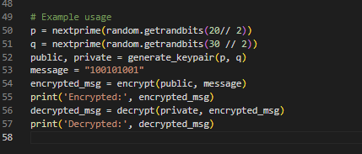

Key Exchange with normal RSA
1.Generation key p and q in the range of prime and generation the public and private key.
2. Send the client send the public key to the server and the server can send the session key to client use the client public key to encrypted,
3. Then client use the private key to decrypted
the session key and use the session key to
communication with the server

Slide 5
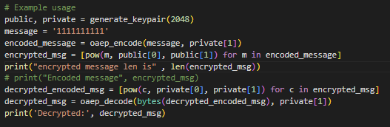
Key Exchange with RSA OAEP
Randomness: Each time a message is encrypted a new random seed is used, which allows the same message to generate a different cipher text each time it is encrypted, preventing replay attacks and some known plaintext attacks.
Data Integrity: With l_hash and padding checks, the decryption process verifies that the data has not been tampered with during transmission.
Resistance to Selected Plaintext Attacks: The structural design of OAEP makes it difficult for an attacker to obtain useful information from the encryption result even if he/she can select the plaintext for encryption, thus enhancing the resistance to attacks.

Slide 6
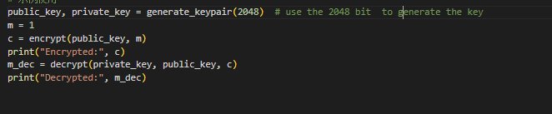
Key Exchange with Pallier
1.Additive Homomorphism: Encrypted values can be directly added, allowing the sum of plaintexts to be computed on ciphertexts.
2.Scalar Multiplication: Multiplying a plaintext by a scalar can be emulated by raising the ciphertext to the power of the scalar.
3.Privacy: Allows computations on encrypted data, ensuring data privacy.
4.Efficiency: Offers straightforward and direct operations on ciphertexts, making it practical for applications requiring data privacy without decrypting.
5.Security: Security relies on the difficulty of factoring large integers and solving problems in composite groups, making it robust against modern computational attacks.

Slide 7
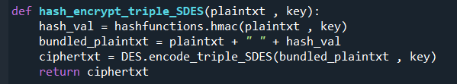
Communicating messages in a secure channel
Use triple SDES
Resistant to meet in the middle attacks and chosen plaintext attacks
Faster encryption times than pkcs
Smaller key sizes than pkcs
Use of HMAC
Ensures integrity of message and that they have not been tampered with
Use SHA1 as hash function

Slide 8
Recap
Upon the start of the program, Client and Server generate their sets of public private keys
Client (customer) establishes a TCP connection with server (bank)
Client chooses a pkc to use (1) RSA, (2) RSA OAEP, (3) Pallier
Client sends over 1,2 or 3 unencrypted to select the pkc
Client and server exchange public keys (unencrypted)
Server generates a symmetric key used for SDES (session key), encrypts it using the Client’s public key and sends it to the Client.
The Client decrypts the message to obtain the session key

Slide 9
Recap continued
Once a session is established, we no longer use PKCs and switch to triple SDES
The client selects a choice (1) Check balance, (2) Deposit, (3) Withdraw, (4) Quit.
If the client selects 1 or 4, Then we just encrypt 1 or 4 and send that to the server
If the client selects 2 or 3, we encrypt “{user_choice} {amount}”
Server can decrypt the user choice on their side and figure out what to do with it
This continues until Client quits

Slide 10
Black Hat, Opponent implementation
Our opponents used textbook RSA to encrypt messages sent between client/server and vice versa
Messages were encrypted letter by letter, where each letter is turned into an integer then encrypted using RSA.
Thus, an encrypted string turns into a list of integers

Slide 11
Black Hat main idea
Main idea: Because the range of primes used in their code is very small (less than 250), a straightforward attack would be to try to decompose the public key n. We can easily list all prime numbers less than 250 and then try all combinations to decompose n and find the corresponding prime number pair. Once the decomposition is successful, we can calculate ϕ(n), and in turn can find the private key d. Some con side: 1. The server is shutdown went client is finished which cannot work with multiply client. 2. Hard code for the account.3. Don’t have the , semantically secure PKC, and homomorphic cipher algorithm. 4.Don’t have the function to check balance. 5. It only check the not deposition negative number but not check for the type which have a chance to make the injection attack.

Slide 12
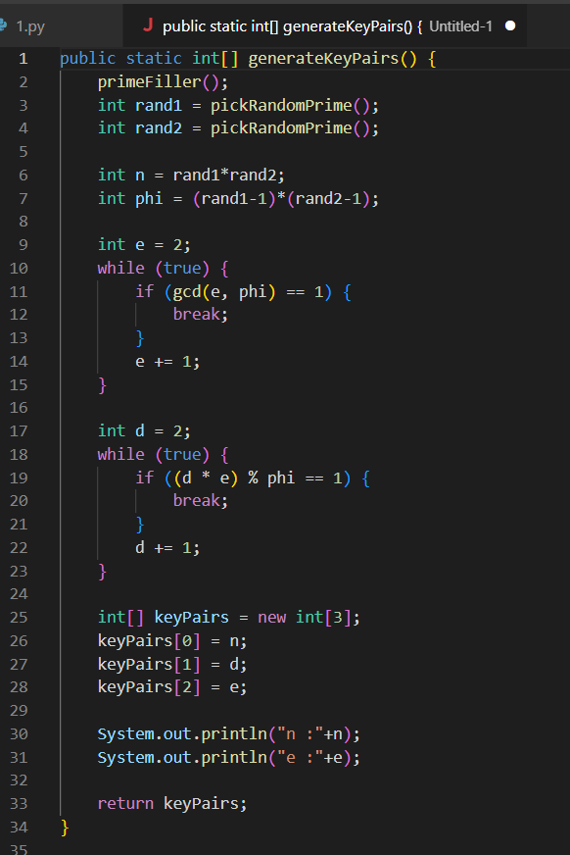
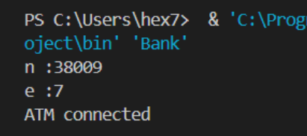
Generate public key and mod n
Generation the public by the method they providence and find the e and n.

Slide 13
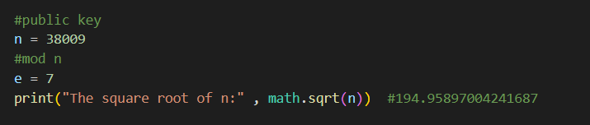
Square root
We'll first round this number down and then take the odd number.
E.g. 194.9589700 become 193

Slide 14
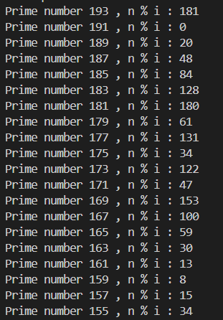
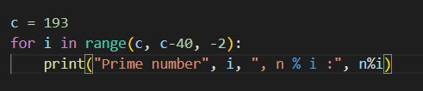
Find p
For each odd number less than the square root of n, we make an attempt to find another prime number.
In this case, we find p = 191.

Slide 15
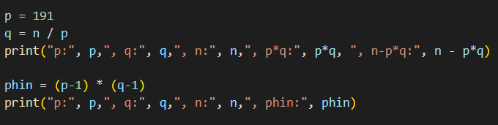
Find q and phin
We then compute q and phin from p and n.

Slide 16
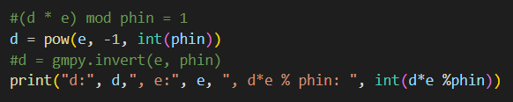
Find private key
We know that e.d=1 mod ø(N)
(d * e) mod phin = 1

Slide 17
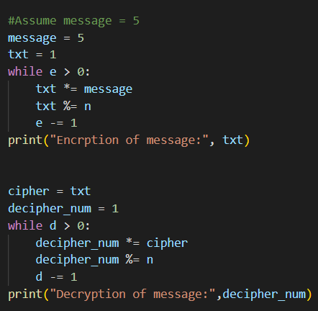

Use the private key to decrypt the message
We take a sample message 5 and encrypt it.
Then we decrypt it with the private key we just obtained and find that it can be decrypted to 5, proving that our decryption is correct.

Slide 18
Other attacks
Meet in middle Attack
Since there is no padding, we can guess the message faster than brute force.
Messages need to be small for this to work: Our opponent encrypted letter by letter, so the messages were guaranteed to be 0-255.
Replay Attack
Our opponent did not use a MAC, so their connection is susceptible to a replay attack
Ind-CPA threat model
Textbook RSA is not semantically secure, since it is deterministic
This can make it vulnerable to other attacks that exploit this weakness

Slide 19
Questions?

